Slide 1
Universal Customer View
Big Data Demonstration
9th - 11th November

Slide 2
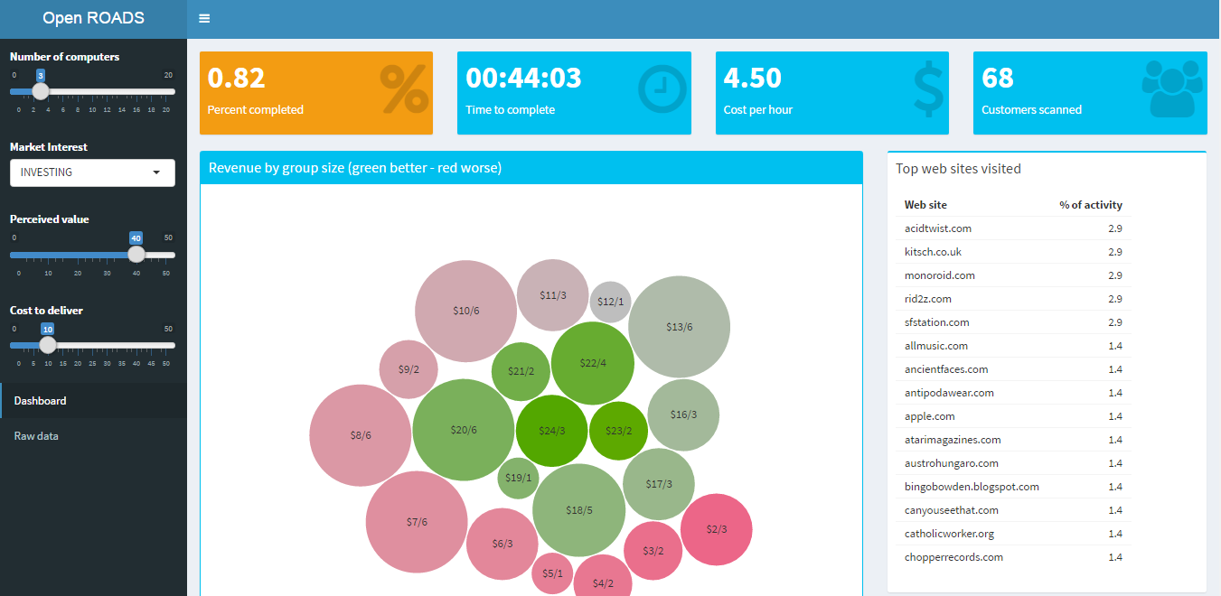
Problem Statement
How much money can we make after a marketing campaign?
Define
Market Interest
Perceived Value
Cost to Deliver
10M customer CRM records
100M PSPU core trace records
External demographic data
Run
Monte Carlo
Simulation
Group customers based
on profit

Slide 3










Solution Architecture
Microsoft Azure
Data
Storage
Hadoop
Cluster
Controller
UI Shinny
Statistics

